Slide 1
Data Structure and Algorithm (CS 102)
R K Mohapatra

Slide 2
Sorting
Sorting refers to the operation of arranging data in some order such as increasing or decreasing with numerical data or alphabetically with character data

Slide 3
Complexity of Sorting Algorithm
The complexity of a sorting algorithm measures the running time as a function of the number on n of items to be sorted

Slide 4
Complexity of Sorting Algorithm
Each sorting algorithm S will be made up of the following operations, where A_{1,} A₂ , ……, A_{n} contain the items to be sorted and B is an auxiliary location:
Comparisons, which test whether A_{i} < A_{j} or test A_{i} < B
Interchange, which switch the content of A_{i} and A_{j} or of A_{i} and B
Assignments, which set B := A_{i} and then set A_{j} := B or Set A_{j} := A_{i}

Slide 5
Sorting
Algorithms are divided into two categories:
Internal Sorts
and
External sorts.

Slide 6
Sorting
Internal Sort:
Any sort algorithm which uses main memory exclusively during the sort.
This assumes high-speed random access to all memory.

Slide 7
Sorting
External Sort:
Any sort algorithm which uses external memory, such as tape or disk, during the sort.

Slide 8
Sorting
Note:
Algorithms may read the initial values from magnetic tape or write sorted values to disk, but this is not using external memory during the sort. Note that even though virtual memory may mask the use of disk, sorting sets of data much larger than main memory may be much faster using an explicit external sort.

Slide 9
Sorting
Sort Stable
A sort algorithm is said to be “stable” if multiple items which compare as equal will stay in the same order they were in after a sort.

Slide 10
Internal Sorting
Bubble Sort
The oldest and simplest sort in use.
Unfortunately, also the slowest.
Works by comparing each item in the list with the item next to it, and swapping them if required.

Slide 11
Bubble Sort
The algorithm repeats this process until it makes a pass all the way through the list without swapping any items.
This causes larger values to "bubble" to the end of the list while smaller values "sink" towards the beginning of the list.

Slide 12
Bubble Sort
Suppose the list of number A[1], [2], A[3], …, A[N] is in memory. Algorithm works as follows.
[1] Compare A[1] and A[2], arrange them in the desired order so that A[1] < A[2]. Then Compare A[2] and A[3], arrange them in the desired order so that A[2] < A[3]. Continue until A[N-1] is compared with A[N], arrange them so that A[N-1] < A[N].

Slide 13
Bubble Sort
[2] Repeat Step 1, Now stop after comparing and re-arranging A[N-2] and A[N-1].
[3] Repeat Step 3, Now stop after comparing and re-arranging A[N-3] and A[N-2].
.
.
[N-1] Compare A[1] and A[2] and arrange them in sorted order so that A[1] < A[2].
After N-1 steps the list will be sorted in increasing order.

Slide 14
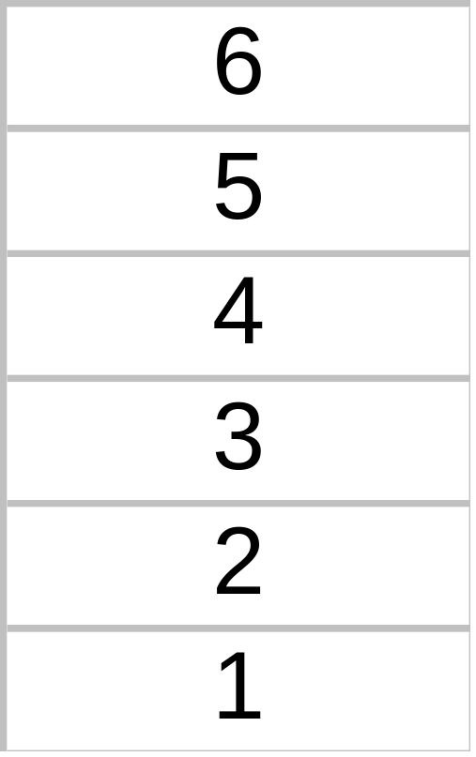
A Bubble Sort Example
Compare

Slide 15
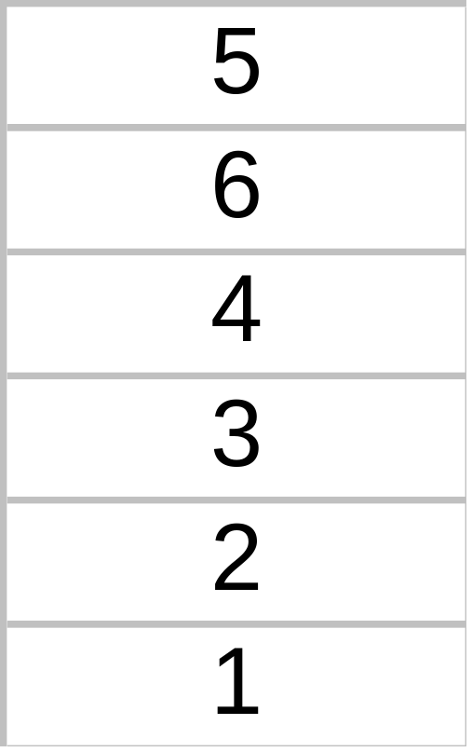
A Bubble Sort Example
Swap

Slide 16
A Bubble Sort Example
Compare

Slide 17
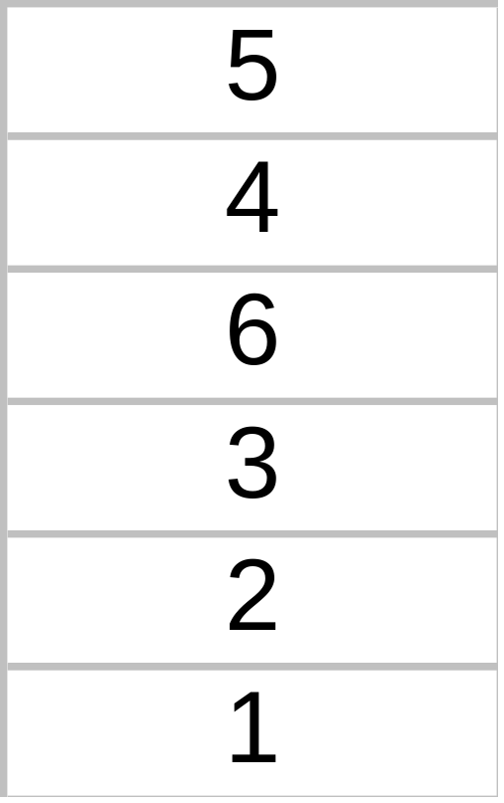
A Bubble Sort Example
Swap

Slide 18
A Bubble Sort Example
Compare

Slide 19
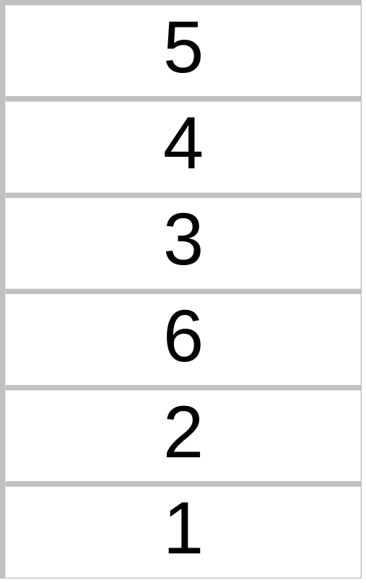
A Bubble Sort Example
Swap

Slide 20
A Bubble Sort Example
Compare

Slide 21
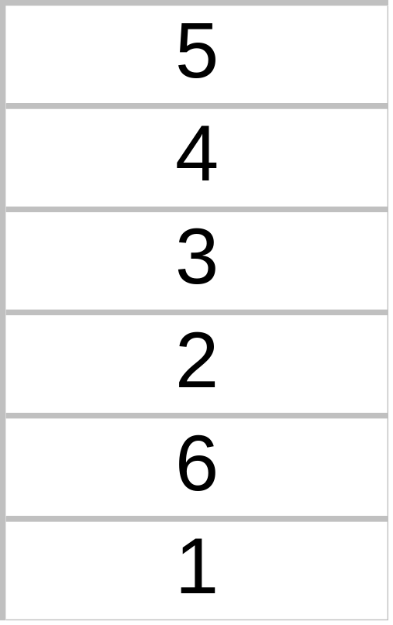
A Bubble Sort Example
Swap

Slide 22
A Bubble Sort Example
Compare

Slide 23
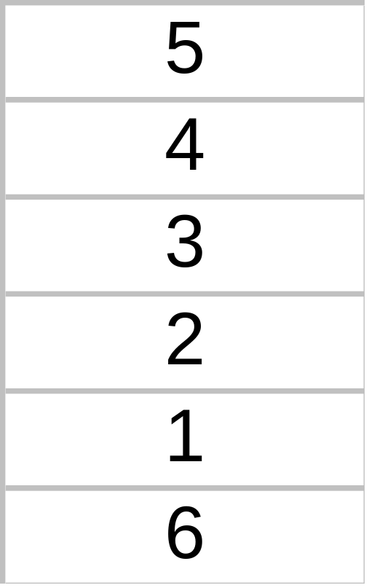
A Bubble Sort Example
As you can see, the largest number
has “bubbled” down, or sunk to the bottom of the List after the first pass through the List.
Swap

Slide 24
A Bubble Sort Example
Compare
For our second pass through the List, we start by comparing these first two elements in the List.

Slide 25
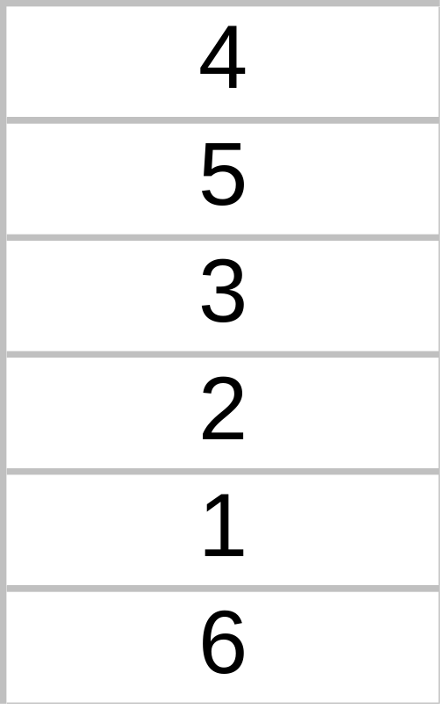
A Bubble Sort Example
Swap

Slide 26
A Bubble Sort Example
Compare

Slide 27
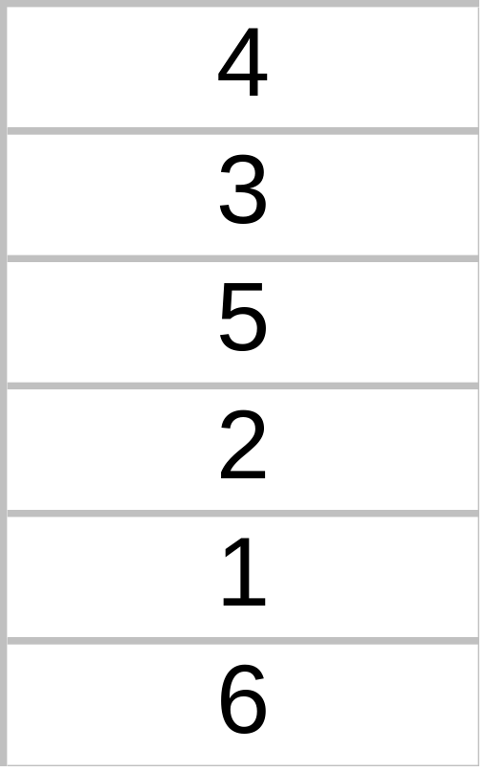
A Bubble Sort Example
Swap

Slide 28
A Bubble Sort Example
Compare

Slide 29
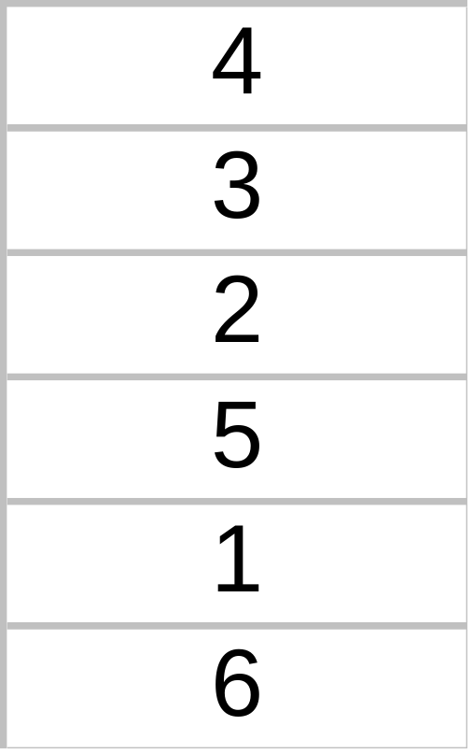
A Bubble Sort Example
Swap

Slide 30
A Bubble Sort Example
Compare

Slide 31
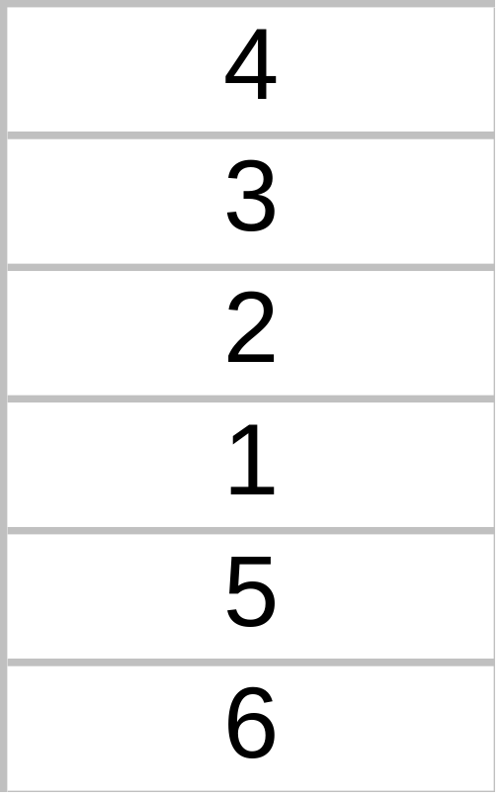
A Bubble Sort Example
At the end of the second pass, we stop at element number n - 1, because the largest element in the List is already in the last position. This places the second largest element in the second to last spot.
Swap

Slide 32
A Bubble Sort Example
Compare
We start with the first two elements again at the beginning of the third pass.

Slide 33
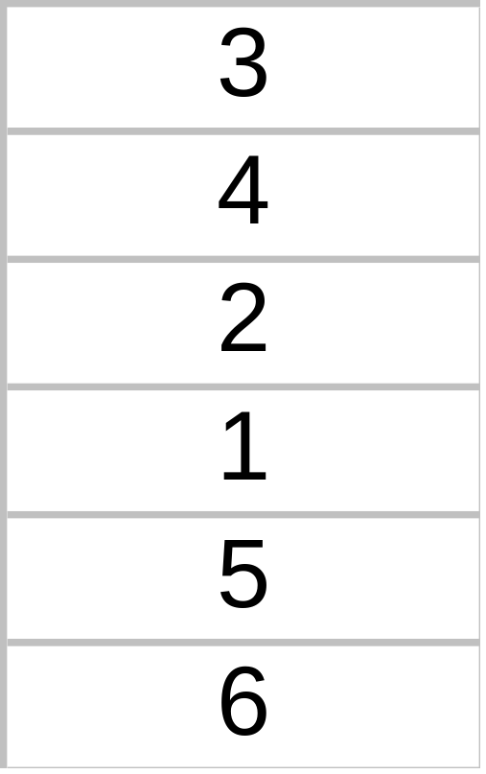
A Bubble Sort Example
Swap

Slide 34
A Bubble Sort Example
Compare

Slide 35
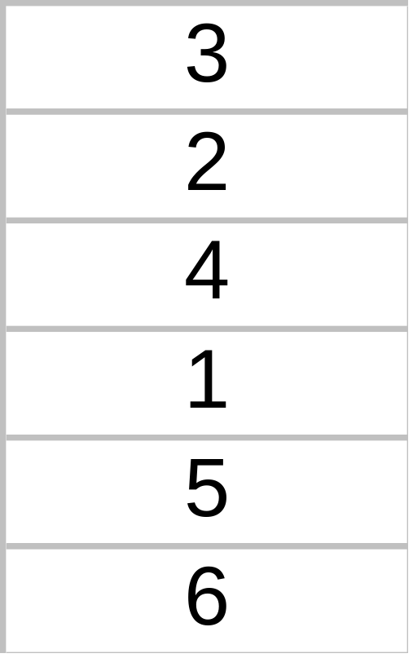
A Bubble Sort Example
Swap

Slide 36
A Bubble Sort Example
Compare

Slide 37
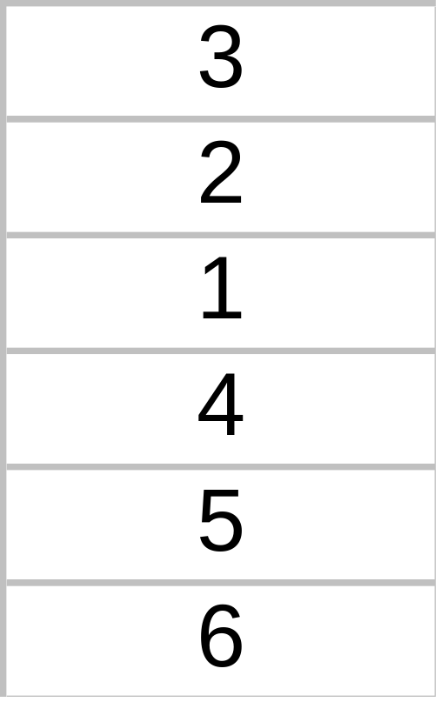
A Bubble Sort Example
At the end of the third pass, we stop comparing and swapping at element number n - 2.
Swap

Slide 38
A Bubble Sort Example
Compare
The beginning of the fourth pass...

Slide 39
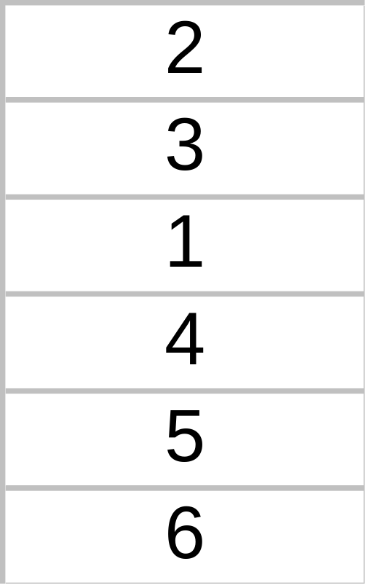
A Bubble Sort Example
Swap

Slide 40
A Bubble Sort Example
Compare

Slide 41
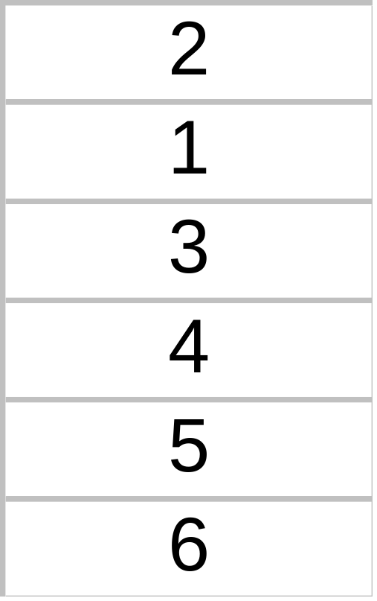
A Bubble Sort Example
Swap
The end of the fourth pass stops at element number n - 3.

Slide 42
A Bubble Sort Example
Compare
The beginning of the fifth pass...

Slide 43
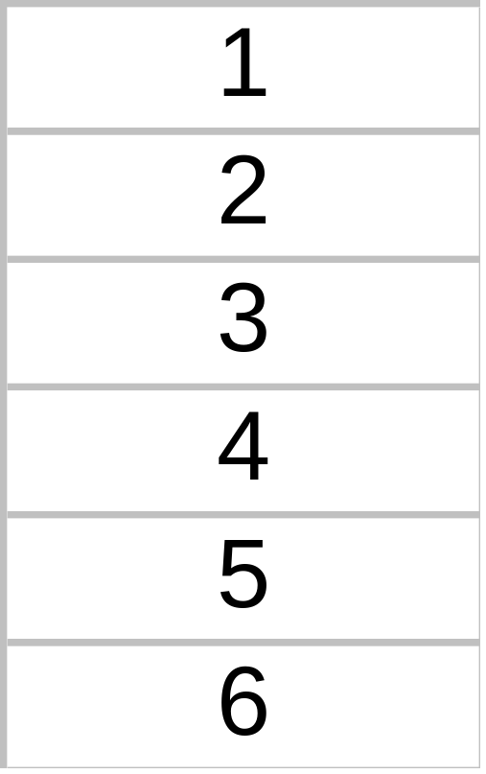
A Bubble Sort Example
Swap
The last pass compares only the first two elements of the List. After this comparison and possible swap, the smallest element has “bubbled” to the top.

Slide 44
What “Swapping” Means
TEMP
6
Place the first element into the Temporary Variable.

Slide 45
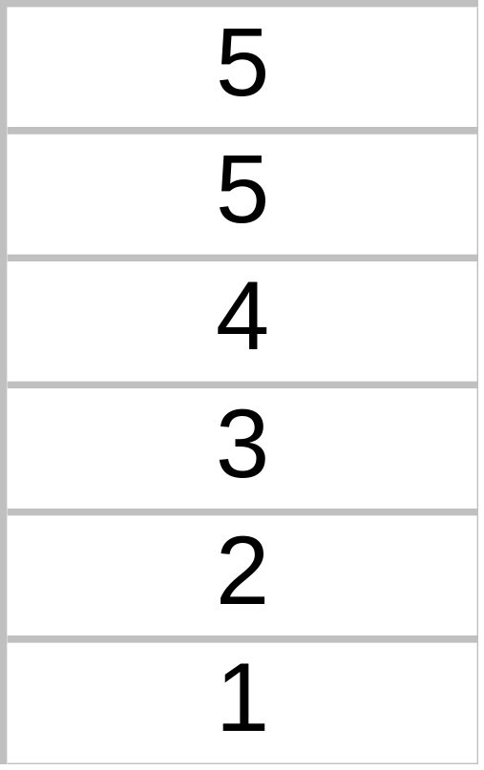
What “Swapping” Means
TEMP
6
Replace the first element with the second element.

Slide 46
What “Swapping” Means
TEMP
6
Replace the second element with the Temporary Variable.

Slide 47
Bubble Sort
DATA is an array with N elements
[1] Repeat Step 2 and 3 for K =1 to N-1
[2] Set PTR :=1
[3] Repeat While PTR <= N –K
(a) If DATA[PTR] > DATA[PTR+1]
Interchange DATA[PTR] and DATA[PTR + 1]
(b) Set PTR = PTR + 1
[4] Exit

Slide 48
Analysis of Bubble Sort
f(n) = (n-1) + (n-2) + …. + 2+1 = n(n-1)/ 2
= O(n² )

Slide 49
Quick Sort
Quick sort is an algorithm of the divide-and-conquer type
The problem of sorting a set is reduced to the problem of sorting two smaller sets.

Slide 50
Quick Sort Approach
1
n
A
Pivot element
A
y ≤ x
x
y ≥ x
Sort recursively
Sort recursively

Slide 51
Quick Sort
To select the pivot
Select the first number FIRST in the list, beginning with the last number in the list, scan from right to left, comparing with each number and stopping at the first number less than FIRST. Then interchange the two number.

Slide 52
44, 33, 11, 55, 77, 90, 40, 60, 99, 22, 88, 66
22, 33, 11, 55, 77, 90, 40, 60, 99, 44, 88, 66
22, 33, 11, 44, 77, 90, 40, 60, 99, 55, 88, 66
22, 33, 11, 40, 77, 90, 44, 60, 99, 55, 88, 66

Slide 53
22, 33, 11, 40, 44, 90, 77, 60, 99, 55, 88, 66
22, 33, 11, 40, 44, 90, 77, 60, 99, 55, 88, 66
First Sublist
Second SubList

Slide 54
Quick Sort Algorithm
Input: Unsorted sub-array A[first..last]
Output: Sorted sub-array A[first..last]
QUICKSORT (A, first, Last)
if first < last
then loc← PARTITION(A, first, last)
QUICKSORT (A, first, loc-1)
QUICKSORT (A, loc+1, last)

Slide 55
Partition Algorithm
Input: Sub-array A[first..last]
Output: Sub-array A[first..loc] where each element of A[first..loc-1] is ≤ to each element of A[(q+1)..r]; returns the index loc
PARTITION (A, first, last)
1 x ← A[first]
2 i ← first -1
3 j ← last +1
4 while TRUE
5 repeat j ← j - 1
6 until A[j] ≤ x
7 repeat i ← i + 1
8 until A[i] ≥ x
9 if i < j
10 then exchange A[i] ↔A[j]
11 else return j

Slide 56
Insertion Sort
An array A with N elements A[1], A[2] … A[N] is in memory
Insertion Sort scan A from A[1] to A[N] inserting each elements A[k] into its proper position in the previously sorted subarray A[1], A[2], …. A[K-1]

Slide 57
Pass 1: A[1] by itself is trivially sorted
Pass 2: A[2] is inserted either before or after A[1] so that A[1], A[2] is sorted
Pass 3: A[3] is inserted in its proper place in A[1], A[2], that is before A[1], between A[1] and A[2] or after A[2] so that A[1], A[2], A[3] is sorted.

Slide 58
Pass 4: A[4] is inserted in its proper place in A[1], A[2], A[3] so that A[1], A[2], A[3], A[4] is sorted.
.
.
Pass N: A[N] is inserted in its proper place in A[1], A[2], A[3], .. A[N-1] so that A[1], A[2], A[3], A[4] , A[N] is sorted.

Slide 59
Insertion Sort Example
Sort an array A with 8 elements
77, 33, 44, 11, 88, 66, 55

Slide 60
Insertion Sort
Pass | A[0] | A[1] | A[2] | A[3] | A[4] | A[5] | A[6] | A[7] | A[8]
K=1 | -∞ | 77 | 33 | 44 | 11 | 88 | 22 | 66 | 55
K=2 | -∞ | 77 | 33 | 44 | 11 | 88 | 22 | 66 | 55
K=3 | -∞ | 33 | 77 | 44 | 11 | 88 | 22 | 66 | 55
K=4 | -∞ | 33 | 44 | 77 | 11 | 88 | 22 | 66 | 55
K=5 | -∞ | 11 | 33 | 44 | 77 | 88 | 22 | 66 | 55
K=6 | -∞ | 11 | 33 | 44 | 77 | 88 | 22 | 66 | 55
K=7 | -∞ | 11 | 22 | 33 | 44 | 77 | 88 | 66 | 55
K=8 | -∞ | 11 | 22 | 33 | 44 | 66 | 77 | 88 | 55
Sorted | -∞ | 11 | 22 | 33 | 44 | 55 | 66 | 77 | 88

Slide 61
Insertion Algorithm
This algorithm sort an array with N elements
[1] Set A[0] = -∞ [Initialize a delimiter]
[2] Repeat Steps 3 to 5 for K = 2, 3, …, N
[3] Set TEMP = A[K] and PTR = K-1
[4] Repeat while TEMP < A[PTR]
(a) Set A[PTR+1] = A[PTR]
(b) Set PTR = PTR -1
[5] Set A[PTR+1] = TEMP
[6] Exit

Slide 62
Complexity of Insertion Sort
Worst Case: O(n²)
Average Case: O(n²)

Slide 63
Selection Sort
Suppose an array A with N elements is in memory. Selection sort works as follows
First find the smallest element in the list and put it in the first position. Then, find the second smallest element in the list and put it in the second position and so on.

Slide 64
Pass 1: Find the location LOC of the smallest element in the list A[1], A[2], … A[N]. Then interchange A[LOC] and A[1]. Then: A[1] is sorted
Pass 2: Find the location LOC of the smallest element in the sublist A[2], A[3], … A[N]. Then interchange A[LOC] and A[2]. Then: A[1],A[2] is sorted since A[1] <= A[2].
Pass 3: Find the location LOC of the smallest element in the sublist A[3], A[4], … A[N]. Then interchange A[LOC] and A[3]. Then: A[1], A[2],A[3] is sorted, since A[2] <= A[3].

Slide 65
Pass N-1: Find the location LOC of the smallest element in the sublist A[N-1], A[N]. Then interchange A[LOC] and A[N-1]. Then: A[1], A[2], ….. , A[N] is sorted, since A[N-1] <= A[N].
A is sorted after N-1 pass.

Slide 66
Selection Sort
Pass | A[1] | A[2] | A[3] | A[4] | A[5] | A[6] | A[7] | A[8]
K=1 LOC=4 | 77 | 33 | 44 | 11 | 88 | 22 | 66 | 55
K=2 LOC=6 | 11 | 33 | 44 | 77 | 88 | 22 | 66 | 55
K=3 LOC=6 | 11 | 22 | 44 | 77 | 88 | 33 | 66 | 55
K=4 LOC=6 | 11 | 22 | 33 | 77 | 88 | 44 | 66 | 55
K=5 LOC=8 | 11 | 22 | 33 | 44 | 88 | 77 | 66 | 55
K=6 LOC=7 | 11 | 22 | 33 | 44 | 55 | 77 | 66 | 88
K=7 LOC=4 | 11 | 22 | 33 | 44 | 55 | 66 | 77 | 88
Sorted | 11 | 22 | 33 | 44 | 55 | 66 | 77 | 88

Slide 67
Complexity
f(n) = (n-1) + (n-2) + …… + 2+ 1 = n(n-1)/2
=O(n² )

Slide 68
Merge Sort
Suppose the array A containing 8 elements
5, 2, 4, 7, 1, 3, 2, 6

Slide 69
1 2 2 4 5 6 7
Merge
2 4 5 7
1 2 3 6
Merge
2 5
4 7
1 3
2 6
Merge
5
2
4
7
1
3
2
6

Slide 70
Time complexity = Θ(n log n)

Slide 71
Heap Sort
4, 1, 3, 2, 16, 9, 10, 14, 8, 7

Slide 72
Heap
16
14
10
8
9
3
7
2
4
1

Slide 73
Heap
14
10
8
10
8
9
4
9
3
7
4
1
3
7
2
1
16
2
14 16
i
i

